Slide 1
Multilevel analysis on new journalistic cultures around the world: the proposal of the Organic Multilevel Model
Worlds of Journalism
Professional Identity, Influences, and Change
International Conference, 5-8 September 2015
Center for Advanced Studies at LMU Munich Seestraße 13, 80802 Munich
Convener: Prof. Dr. Thomas Hanitzsch
Martín Oller Alonso PhD
University of Americas (UDLA)
Quito, Ecuador

Slide 2
Introduction
Worlds of Journalism
International Conference
5-8 September 2015
This paper presents an analysis of the context influences in journalist through the application of multilevel models in studies around the world.
The last decade has seen the consolidation of the comparative studies of journalistic culture beyond of single country or western journalism studies. This tendency contrast different point of view of journalists within their journalistic cultures based on the context influences from the most important systems -economic, political, social, media, etcetera- and technology.

Slide 3
Organic multilevel model
Worlds of Journalism
International Conference
5-8 September 2015
This work shows the Organic Multilevel Model based on the concept of organic analysis of journalism, supported on the ideas of dynamism, change and heterogeneity that define the journalistic culture of denominated as Intermediate Journalistic Countries.
https://culturasperiodisticas.com/

Slide 4
context
Worlds of Journalism
International Conference
5-8 September 2015
CULTURE
JOURNALISTIC CULTURE
WESTERN JOURNALISTIC CULTURE
JOURNALISTIC CULTURE of ECUADOR
INTERMEDIATE JOURNALISTIC CULTURE
Figure 1: Multilevel models of context of Journalistic Culture
Source: Author´s elaboration

Slide 5
context
CULTURA PERIODÍSTICA
Worlds of Journalism
International Conference
5-8 September 2015
CULTURE
JOURNALISTIC CULTURE
INTERMEDIATE JOURNALISTIC CULTURE
LATIN AMERICA AND CARIBBEAN
JOURNALISTS
JOURNALISTIC CULTURE OF ECUADOR
Figure 2: Multilevel models of context of Intermedia Journalistic Culture
Source: Author´s elaboration

Slide 6
multilevel models
Worlds of Journalism
International Conference
5-8 September 2015
 | Individuals | Media routines | Media organization | Media structure | Society (Policy & Economy) | Culture & Ideology
McQuail (1983)
Ettema & Whitney (1982)
Chaffee & Berger (1987)
McQuail & Windahl (1993)
Weischenberg (1992,1995)
Reus (1998)
Shoemaker & Resse (1996)
Esser (1998)
Whitney et al. (2004)
Grossberg et al. (2006)
Donsbach (2000,2008)
Preston & Metykova (2009)
Hanitzsch et al. (2010)
Oller & Meier (2012)
TABLE 1: Synopsis of multilevel models
Source: Author´s elaboration of data from Hanitzsch (2009: 156)

Slide 7
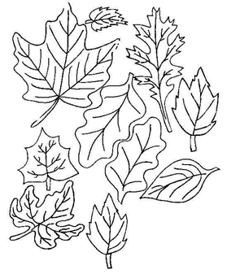
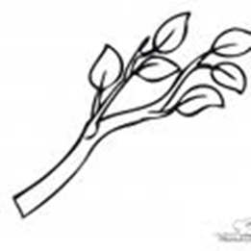
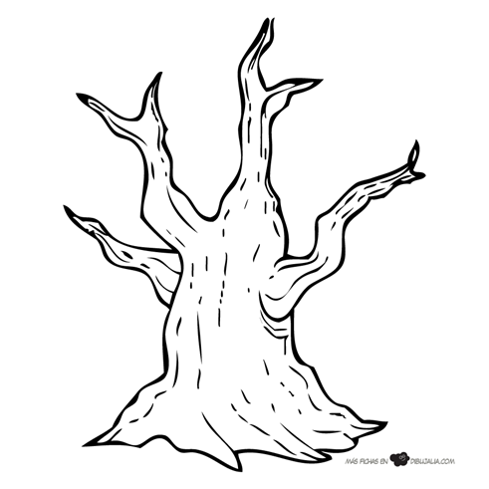
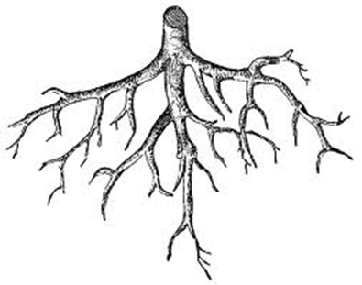
organic analysis
Worlds of Journalism
International Conference
5-8 September 2015
multilevel models
+
“Much of what we study in nature is multilevel, so we must use the theories and analysis techniques that are also multilevel. If we do not this, we have serious problems” (Luke, 2004: 4)
Leaves
Branches
Trunk
Roots

Slide 8
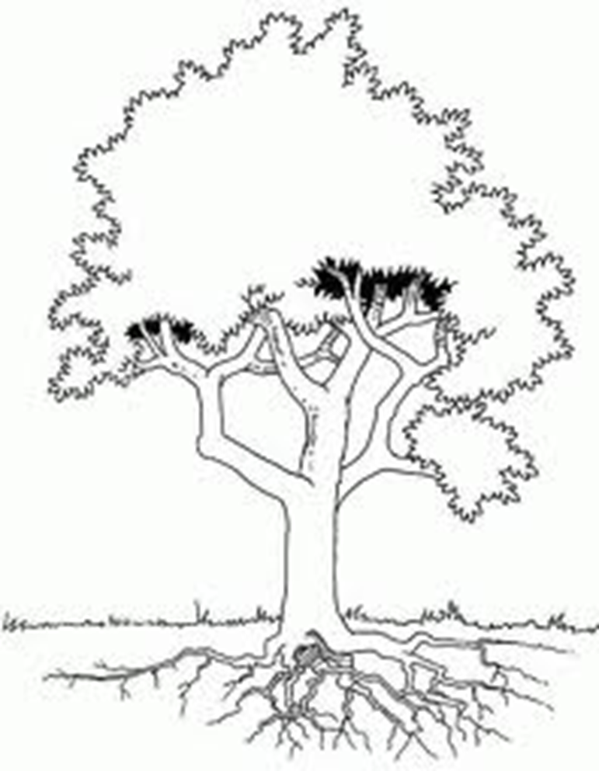
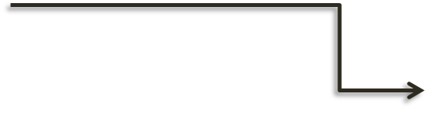
ORGANIC multilevel model
Worlds of Journalism
International Conference
5-8 September 2015
(OLLER, 2015)
Actor Level
INFLUENCES
Sociodemographic factors
Economic factors
Political factors
Professional/personal roles
Institutional level
Media Organization
media structure
Media rutines / processes
Editorial line /rules
Profile journalists
Systems Level
Political system (role, parallelism)
Economic system (market structure)
Professionalization (academy)
Historical/Social system
technology
MEDIA SYSTEM
Figure 3: Organic multilevel model
Source: Author´s elaboration

Slide 9
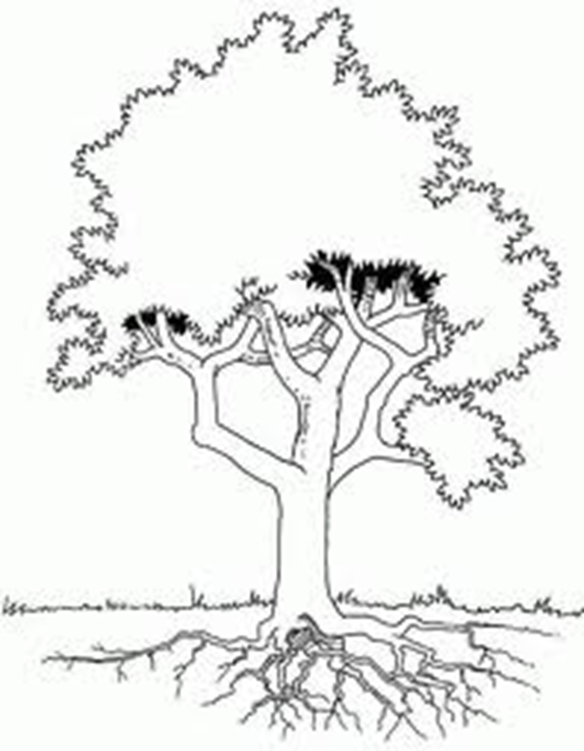
ORGANIC context ANALYSis of ecuador
Worlds of Journalism
International Conference
5-8 September 2015
New middle class
Low salaries / salary increase
Polarization
City vs province
Not self-regulation
Public /private /community
Vertical processes
Editorial line for or against the government
Low professionalization
Hybrid system (democracy)
New law of communication (2013)
Strong interventionist state
State paternalism / crispation
Neocapitalism vs Socialism
Professional training: Title vs Empirical
Inestability
Social individualism
Technological asynchronism
Current structure of the media in Ecuador: 91% Private, 5% Public and 4% Community media
Figure 4: Organic analysis of Ecuadorian Journalists
Source: Author´s elaboration

Slide 10
CONCLUsION
Worlds of Journalism
International Conference
5-8 September 2015
JOURNALISTICCULTURE OF ECUADOR
The outcomes of this study show an evolution and a complementary viewpoint of the transcultural comparative media research approach, where the journalistic culture of each country is not a subordinate culture of other -Western countries-, with its own media flows and journalistic products and practices. As Couldry (2012) maintains, media cultures are the result of territorial or deterritorialised thickenings or amalgamations.
This research follows the tendency expressed by Hanitzsch (2008: 116): “another important task for the future is the development of concepts and research instruments that deliberately serve a comparative purpose and that extend beyond Western-grown models”.
In order to consistently study journalism culture, we have designed the Organic Multilevel Model.

Slide 11
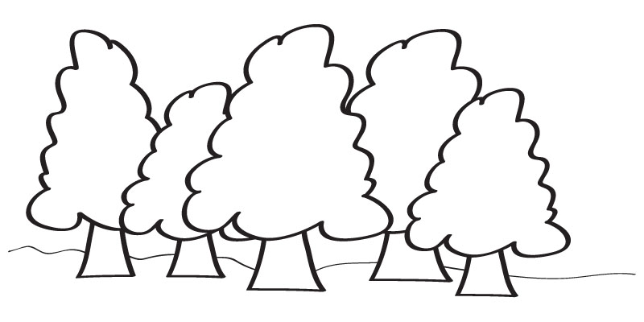
THANKS

