Slide 1


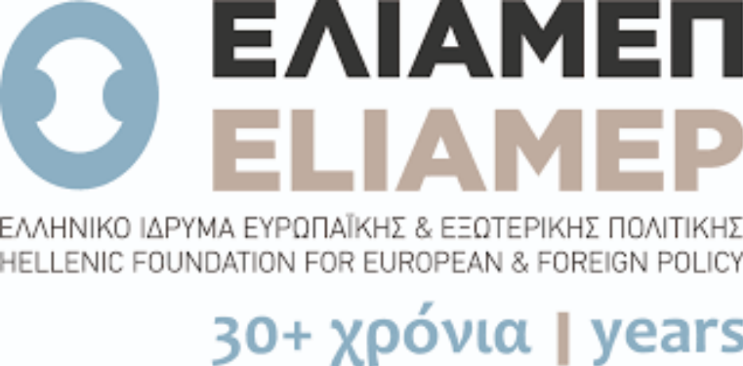

Monitoring mediascapes:
Diachronic comparative meta-analysis of deliberative communication in the European Union. Risks and Opportunities
Martín Oller Alonso
Department of Sociology and Communication, University of Salamanca (USAL)
Marie Skłodowska-Curie Actions-H2020-MSCA-COFUND-2020-USAL4EXCELLENCE-PROOPI-663
COIN project - Countering Online INtolerance against especially vulnerable groups
Member of OCA (Observatorio de Contenidos Audiovisuales) of USAL
Member of the Italian Team in MediaDelCom
Project leader of Cultura Periodística (pre)profesional en Ecuador

Slide 2

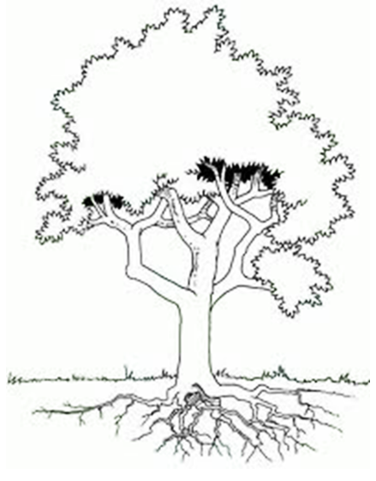
Austria
Bulgaria
Croatia
Czech Republic
Estonia
Germany
Greece
Hungary
Italy
Latvia
Poland
Romania
Slovakia
Sweden
Mediascapes
[media landscapes]
Wisdom-based media policy [and governance]
Monitoring capability (MM) (for MEDIADELCOM) of EU mediascapes [Meta-análisis] based on deliberative communication: SCENARIOS.
Examination of knowledge production relating to the four identified domains, the coherence of data collection, the proliferation of data, the formulation of knowledge, and its application in the crafting of media policies.
Agents & Structures
[Archer, 1995]
Realist Social Theory
Method of diachronic comparative meta-analysis for the monitoring capabilities of deliberative communication
WISDOM
micro
KNOWLEDGE
meso
INFORMATION
Pyramid of wisdom (DIKW) [Rowley, 2007]
[OMM2] in diachronic
perspective (2000-20)
Context
DATA
macro

Slide 3
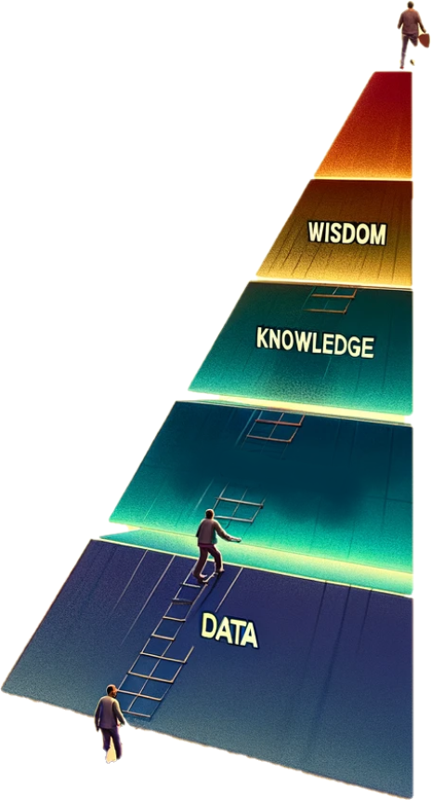

METHOD OF DIACHRONIC COMPARATIVE META-ANALYSIS FOR THE MONITORING CAPABILITIES OF DELIBERATIVE COMMUNICATION
This Method offers a comprehensive evaluation of risks and opportunities for deliberative communication that are reflected in the mediascapes monitoring data and the extent of research on news media transformations in the European Union over the past two decades (2000–2020).

Slide 4
Method of diachronic comparative meta-analysis for the monitoring capabilities of deliberative communication
3 step
Deliverable-2.1-the-First-case-study
Domains DATABASE (Systematization of variable and countries)
Bibliographical database
Theoretical proposal
Theoretical + empirical study
Knowledge
NATIONAL (compilation)
5 step
4 step
Wisdom-Based-Media-Governance
BOOK
Monitoring mediascape
Information
Knowledge
INTERNATIONAL
Wisdom
INTERNATIONAL
0 step
1-2 step
(0) Study object: Theoretical proposal
(1) National bibliographic review: Monitoring capability
(2) Systematization: (Trans)National bibliographical databases
(3) (Trans)National Reports (theoretical proposal + bibliographical diachronic review)
(4) Data mining from reports: Diachronic comparative meta-analysis - (Trans)National Domain databases
(5) Data-Based-Media-Governance (theoretical comparative proposal + diachronic comparative meta-analysis)
Data Information
NATIONAL

Slide 5
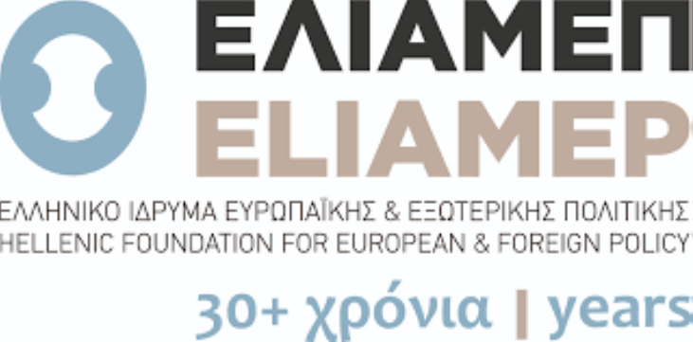
ORGANIC MULTILEVEL MODEL 2.0

Slide 6
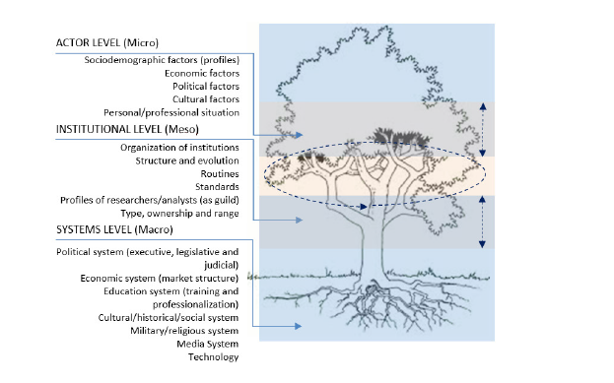
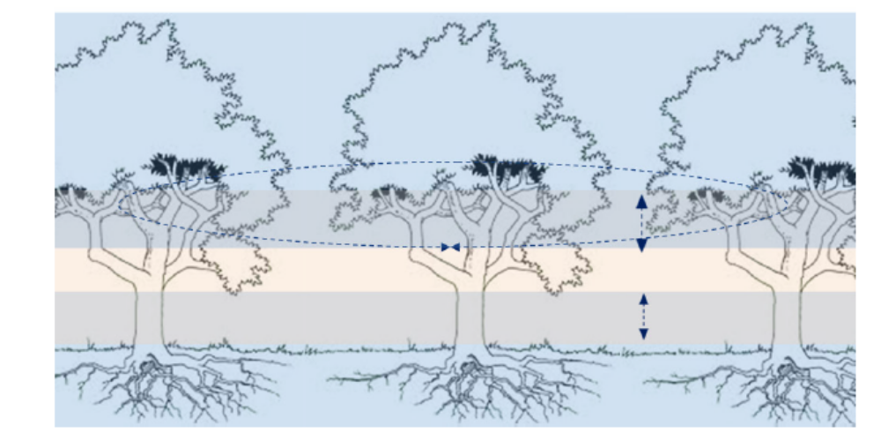
ORGANIC MULTILEVEL MODEL 2.0 (OMM2)
Agents & Structures
[Archer, 1995]
ACTOR LEVEL (Micro)
Sociodemographic factors (profiles)
Economic factors
Political factors
Cultural factors
Personal/professional situation (professionalism)
INSTITUTIONAL LEVEL (Meso)
Organization of institutions
Structure and evolution
Routines
Standards
Profiles of researchers/analysts (as guild)
Type, ownership and range
SYSTEM LEVEL (Macro)
Political system (executive, legislative and judicial)
Economic system (market structure)
Education system (training and professionalization)
Cultural/historical/social system
Military/religious system
Media System
Technology
Global Political system (political landscapes, transnational structures)
Global economy (trade, markets, fiscal, interconnected system)
Global Education (international educational policies)
Cultural/historical/social global system (trends, values, phenomena, social systems worldwide)
Ideological transnational perspective (transcend boundaries, belief systems globally)
Military/religious system (global security dynamics, alliances, conflicts)
Media System (transnacional platforms, internacional media policy)
Technological global system (interconnection, transnational companies, global scale)
TRANS-SYSTEMIC LEVEL (Supra)
Oller Alonso, M. (2023). “Not See the Forest for the Trees.” The Significance of Context in Media Monitoring Capabilities from a Comparative Perspective. Media Literacy and Academic Research, 6(2): 79-100.

Slide 7

DIACHRONIC DEVELOPMENT
What are the potential risks and opportunities associated with meta-analysis of deliberative communication in the European Union?

Slide 8

1. Narrow scope of research or small empirical samples, leading to fragmented knowledge that hinders the identification of media-related risks in deliberative communication​​.
2. Research that only covers a short period, leading to a lack of knowledge on changes in mediascapes and potential knowledge loss due to researcher turnover or project-based research policies​​.
3. Incomplete national data on financing JMC studies, indicating risks in research governance, and the potential for instability and unpredictability due to performance-based research funding systems​​.
4. Lack of attractiveness of academic careers in countries with a short tradition of JMC research and a small number of experts​​.
5. Difficulty in assessing available information and knowledge regarding media-related competencies, especially in multidisciplinary domains where JMC aspects are secondary​​.
6. Limited national funding for research projects, which creates risks, and reliance on non-academic actors or NGOs for funding​​.
7. Differences in risks between “old Wes” and post-soviet countries, with some countries facing specific factors that increase risk​​.
8. Insufficient knowledge in certain domains, such as freedom of speech, information accountability, market and organizational conditions, and journalistic competencies in various countries​
1. Continuity in research as a response to the challenge of diachronic research scope and knowledge continuity​​.
2. Introducing network-based policies for financing research and setting research agendas tailored to the needs of individual countries could turn risks into opportunities​​.
3. Addressing the gap in research on the ethical competencies of lay members concerning public communication, which has grown rapidly in the 21st century​​.
4. Countries with a long tradition of research and a well-recognized discipline, like Austria, Sweden, and Germany, present opportunities for stable and continuous development​​.
5. Utilizing cooperative engagements, mutual learning, and a shared commitment to transparent and accountable mediascapes to enhance wisdom-based media governance​​.
6. In countries with a good organizational framework and resources for funding, like Bulgaria and Poland, there is an opportunity for continuous development of JMC studies​​.
7. The presence of academic freedom and the availability of data and resources for JMC research allow for the possibility of conducting longitudinal studies and addressing knowledge gaps​​.
8. Support for studies that align with societal needs and policymakers, especially in cases of limited financial resources, can lead to more targeted and impactful research outcomes​
LACK/GAPS/DEFECTS/OVERPROCUTION OF KNOWLEDGE
NETWORK-BASED POLICIES
FRAGMENTATION
ETHICAL COMPETENCIES
SHORT TRADITION
POOR SEASONALITY
COUNTRIES WITH
STABLE DEVELOPMENT
LOW MEDIUM/LONG PLANNING
CONCENTRATION OF KNOWLEDGE
INDIVIDUALIST RESEARCH AGENDA/ LACK COLLABORATION
MISSING, CONCENTRATING OR INCOMPLETE DATA
COUNTRIES WITH
STABLE DEVELOPMENT
ALIGN WITH
SOCIETAL NEEDS
(S)LOW MEDIUM/LONG PLANNING
PATH DEPENDENCY
COOPERATIVE ENGAGEMENTS
MUTUAL LEARNING
OLD WEST
NEW EAST
LONG TEMPORAL LONGITUDINAL STUDIES
LIMITED NATIONAL FUNDING
BUSINESS LOGIC
ACADEMIC FREEDOM
AVAILABILITY OF DATA
INSTABILITY & UNPREDICTABILITY IN RESEARCH GOVERNANCE
CONTINUITY IN RESEARCH
DIVERSE AND SUFFICIENT
DEPENDENCY ON INTERNATIONAL FUNDS AND PROJECTS
SCOPE OF INVESTIGATIONS

Slide 9
CONCLUSION
Diversity in Media Monitoring: Acknowledges varied media monitoring capabilities across EU nations, with distinct differences between Western democracies and post-Soviet countries.
Balancing Risks and Opportunities: Stresses the need for a balanced approach in media governance, considering both risks and opportunities.
Strategic Approaches: Suggests strategies like network-based policy financing, addressing information overload, and regular data collection mechanisms.
Wisdom-based Media Governance: Advocates for a governance model based on cooperation, mutual learning, and a transparent, accountable, wisdom-driven media landscape.
National bibliographic review
Monitoring capability
Systematization
(Trans)National
(Trans)National
Reports

Slide 10


MEDIADELCOM project was funded by the Research and Innovation Program Horizon 2020 of the European Union within the framework of the Fund under grant agreement No. 101004811.
Martín Oller Alonso
Department of Sociology and Communication, University of Salamanca (USAL)
Marie Skłodowska-Curie Actions-H2020-MSCA-COFUND-2020-USAL4EXCELLENCE-PROOPI-663
COIN project - Countering Online INtolerance against especially vulnerable groups
Member of OCA (Observatorio de Contenidos Audiovisuales) of USAL
Member of the Italian Team in MediaDelCom
Project leader of Cultura Periodística (pre)profesional en Ecuador

